Slide 1



Slide 2




Optimizing Your Job Search: Successful Strategies for a Job by June
with
Rachel Gakenheimer
Manager of Applied Learning
HGSE Career Services Office
January 23rd, 2019 4-5pm

Slide 3
Two Phases
PHASE 1:
PREPARE
(starts now! Regardless of sector of interest)
PHASE 2:
APPLY
(start-time depends on your sector of interest)

Slide 4




Step 1.1: Develop a List of Target Organizations
20-40 orgs on target list
Guidestar + Foundation Center is now Candid.org – access via old Guidestar links

Slide 5


Step 1.2: Make Connections
Create long-term relationships
Get referrals
Learn about hiring process

Slide 6

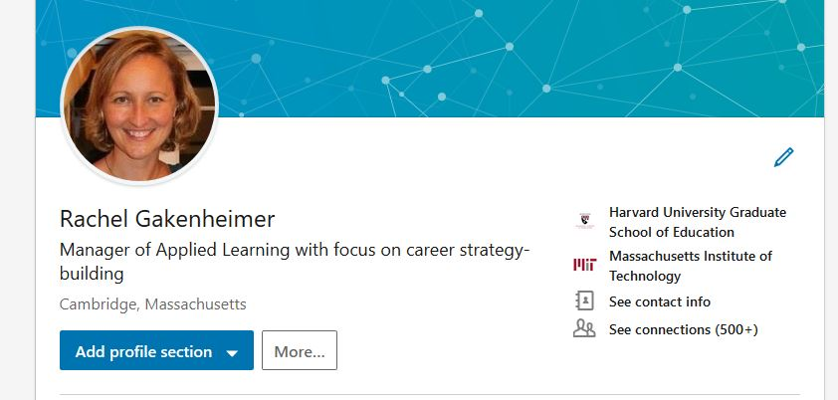
Step 1.3: Update Your Marketing Materials
Resume
Cover Letter
LinkedIn Profile

Slide 7


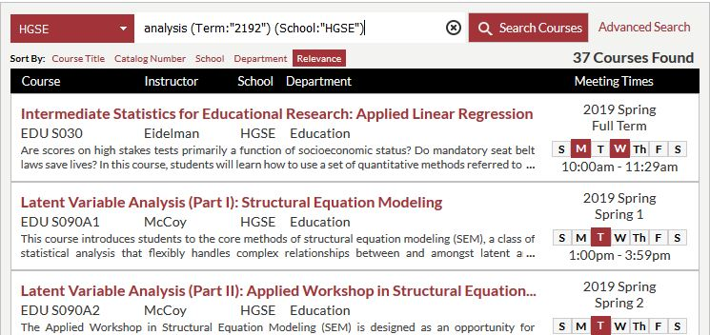



Step 1.4: Review Spring Courses & Programming

Slide 8
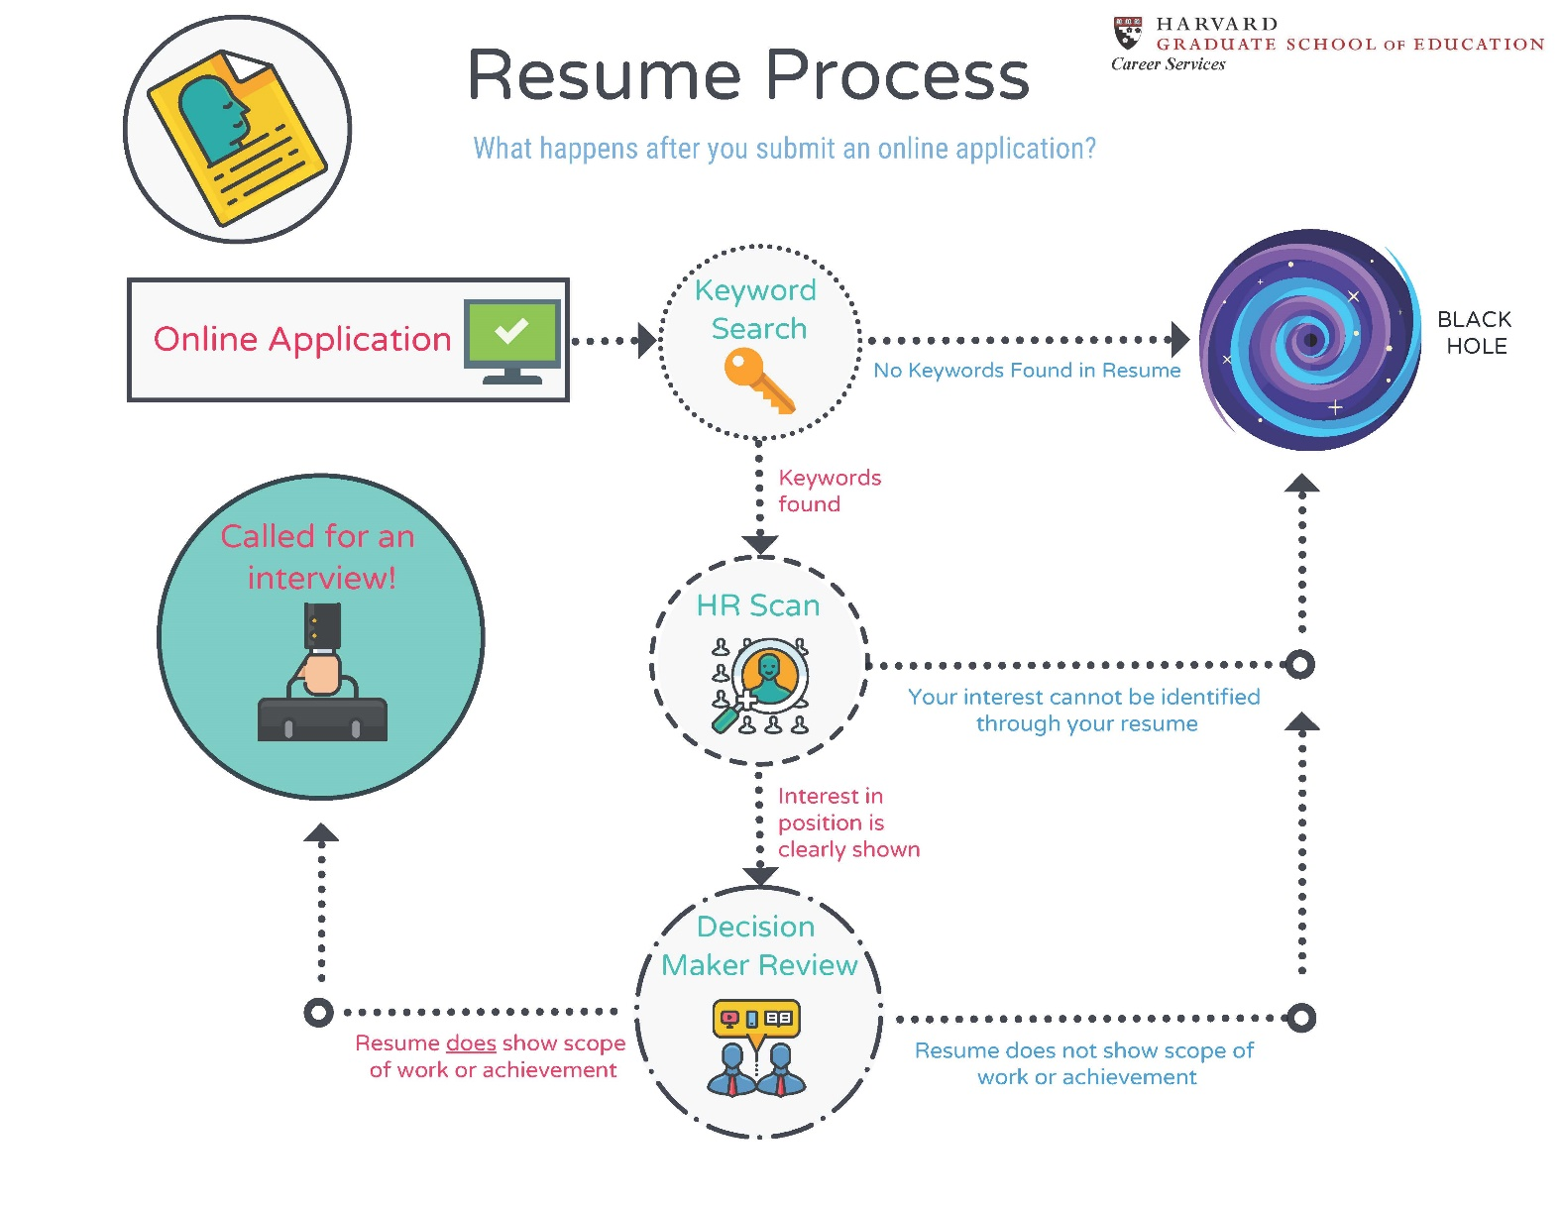
Phase 2: Apply!

Slide 9











Step 2.1: Find Positions of Interest to You
Key places to check for positions:
Organization’s website
Professional organizations & publications for your sector of choice
Webcrawlers, like Indeed.com and USAJobs.gov

Slide 10

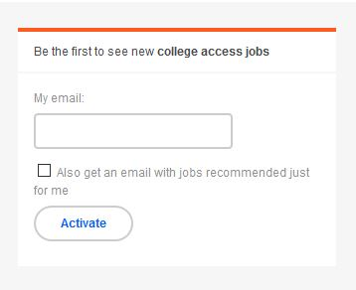
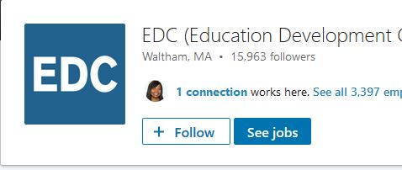
Step 2.2: Set up job-search agents and webcrawlers

Slide 11


Step 2.3: Create follow-up materials

Slide 12
Key Application Tips
Apply during first two weeks of posting
Prepare for salary negotiation in spring
Submit 2-3 applications / week
Follow up!
  Interviewers
  Direct Supervisor
“Do not contact” means “Do not contact HR” – Always a good idea to follow up!

Slide 13
Time-to-Hire Timeline
November application start-time
Govt: 120 days TTH; start now!
K12 Independent & Charter: start now! ; positions available through August
Feb application start-time
K12 Public: 60-90 TTH; positions available through August
March application start-time
Nonprofit: 60-90 days TTH; as positions become available
Niche Consulting: 60-90 day TTH; Orgs with founders and directors with corp background, may have shorter time-to-hire (30-45 TTH); join EdConnect trip.
Higher Ed: Student Services 60-90 days TTH; positions available in March through July; Operations positions throughout the year
April application start-time
Media and Tech: 30-45 days TTH
Corporations: 30-45 day TTH
Startups: 30-45 days TTH; faster TTH

Slide 14
Resource Links
Guidestar (now merged with Foundation Center to form Candid.org): Hollis → Guidestar → View online
LinkedIn HGSE Alumni page: www.linkedIn.com → Search for: Harvard University Graduate School of Education → Click on Alumni button
Application Trackers: cso.gse.harvard.edu → Engage with Employers → Select sector pathway → Resources (not available for all sectors. If not available for yours, select any and tailor)
Resumes and profiles: https://cso.gse.harvard.edu/resumes-profiles
Cover Letters: https://cso.gse.harvard.edu/cover-letters-portfolios
Events on Hub: https://communities.gse.harvard.edu/hgsehub/s/
Tips on using Guidestar and LinkedIn

Slide 15

Any questions?
Email rachel_gakenheimer@gse.harvard.edu

