Slide 1
Nonprofit Resume Workshop
with Rachel Gakenheimer
Thursday, February 13, 4-5pm
Larsen G01

Slide 2
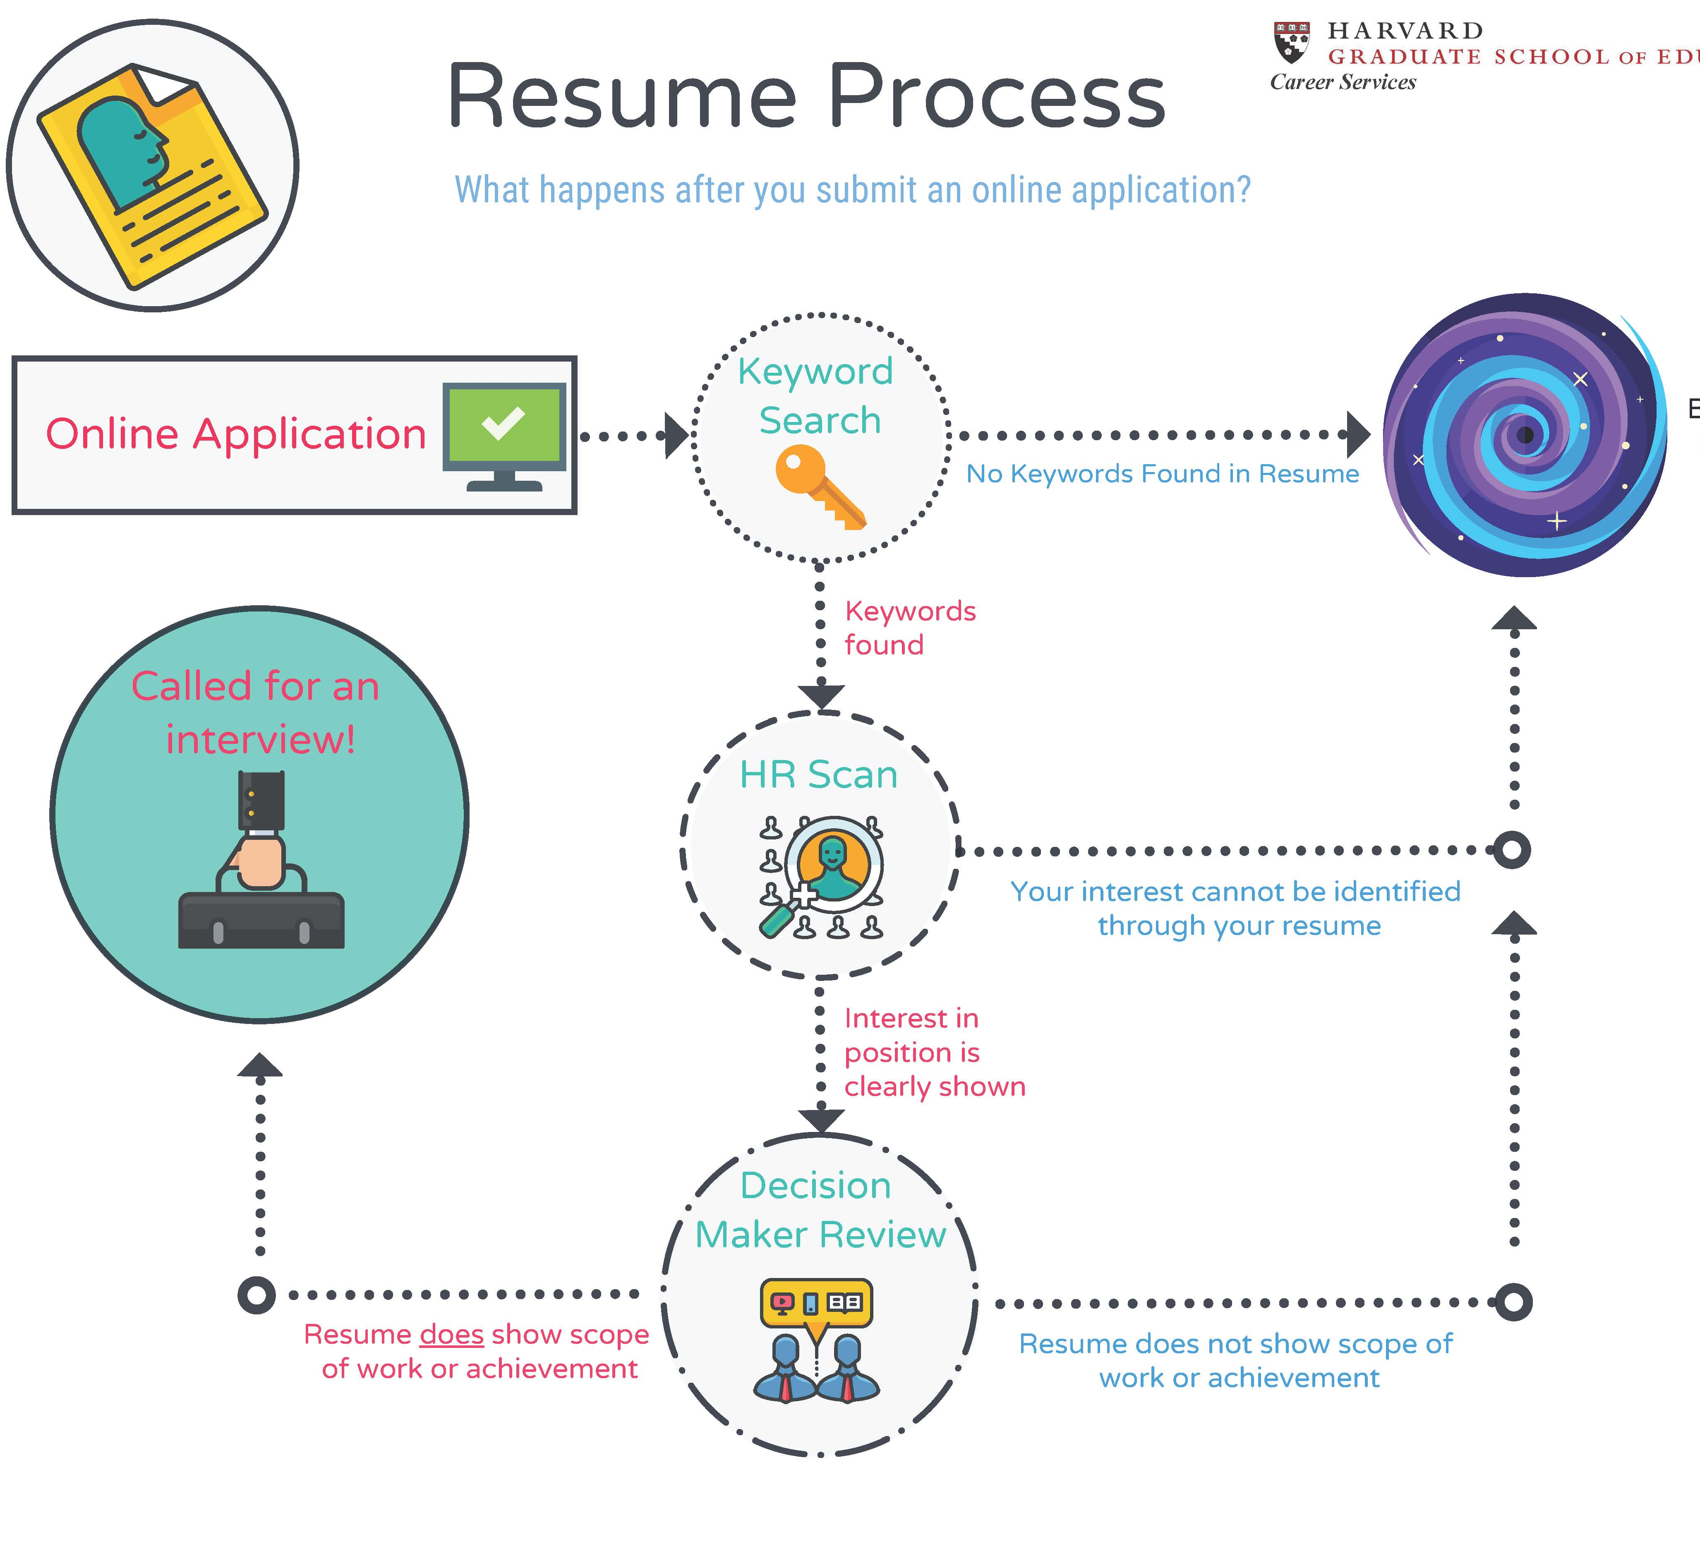
Three-part Review

Slide 3

Shift Your Perspective

Slide 4
Organizing Your Story:
Job Description Responsibilities
The Program Director will have responsibilities in the following areas:
Program Development
Define the program’s policy goals, intermediate objectives, priority activities, and benchmarks for measuring progress and relate those goals to the Foundation’s overall mission;
Monitor the field: reading, attending meetings, developing relationships so as to understand emerging issues, research, political, and technological developments that affect the program
Proposal Evaluation and Project Oversight
Evaluate proposals to determine if: the proposed project is consistent with and could further the policy goals of the program; the applicant has the staff, resources, policy opportunities, and strategy to carry out the proposed project successfully
Present at proposal review meetings recommendations for action on funding requests and the reasons for the recommendations
Management of Program Team
Meet with program team members – an Education Program Officer and an Education Program Assistant – to develop performance plans and their implementation; provide appropriate feedback on performance in annual review; provide training, mentoring, and oversight for program team;
Provide leadership in and coordinate planning and implementation of strategic directions; track program budget and ensure that program team is on track with goals and benchmarks set in planning process; ensure that schedules for program development and proposal review are adhered to and that deadlines for board book preparation, providing materials for other foundation functions such as communications, and other tasks are met.
External Relations
Responsible for developing and maintaining relationships with x, y, z

Slide 5
Organizing Your Story:
Hybrid Resume
Program Development Experience
ORGANIZATION NAME 2016-present
Your role
Defined the program’s benchmarks for measuring progress and ensured those goals to the ;
Developed relationships to understand (xxx) issues, research, political, and technological developments that affect the program
ORGANIZATION NAME 2010-2012
Your role
Examined and refined a grant budget that (shows how prudently maximized goals);
Solicited proposals consistent with the program’s strategy and goals through a process of reviewing letters of inquiry, site visits, and other meetings
Proposal Evaluation Experience
HGSE COURSE, HGSE Fall 2019
Project Name
Researched
Evaluated
ORGANIZATION NAME 2015-2016
Your role
Evaluated proposals to (and how you used your skills to evaluate said proposal);
Worked closely with
Monitored projects and grant reports …
Program Management Experience
ORGANIZATION NAME 2012-2014
Your role
Facilitated the development of performance plans and their implementation; provide appropriate feedback on performance in annual review; provide training, mentoring, and oversight for program team;
Managed x program…

Slide 6
Organizing Your Story:
Reverse Chronological
PROFESSIONAL EXPERIENCE
ORGANIZATION NAME 2016-present
Your role
Program Development Experience
Defined the program’s benchmarks for measuring progress and ensured those goals to the xxx;
Developed relationships to understand (xxx) issues
Research Experience
Researched political and technological developments that affect the program
ORGANIZATION NAME 2015-2016
Your role
Evaluated proposals to (and how you used your skills to evaluate said proposal);
Worked closely with …
Monitored projects and grant reports …
ORGANIZATION NAME 2014-2015
Your role
Examined and refined a grant budget that (shows how prudently maximized goals);
Solicited proposals consistent with the program’s strategy and goals through a process of reviewing letters of inquiry, site visits, and other meetings
EDUCATION
HGSE
EdM Exp May 2020

Slide 7
Organizing Your Story:
Transferable Skills
Research Experience
SCHOOL NAME 2014-present
Teacher Leader
Promoted consecutively over from Teaching Assistant to Teacher Leader
Program Development Experience
Defined the program’s benchmarks for measuring progress;
Developed relationships to understand (xxx) issues.
Researched political, and technological developments that affect the program
Proposal Evaluation Experience
Evaluated proposals to (and how you used your skills to evaluate said proposal);
Monitored projects …
Worked closely with …
Program Management Experience
Facilitated the development of performance plans and their implementation; provide appropriate feedback on performance in annual review; provide training, mentoring, and oversight for teaching team;
Managed x program…

Slide 8
Success and Scope of Work:
Make Your Resume Stand Out
Assistant Director for Leadership Development
Supervised 14 interns in delivering academic counseling, college guidance, public policy internship and employment to over 450 high school students
Managed budget of over $2k
Built relationships with NYC independent school administrators to manage xxx
Managed staff and teachers during 16 separate three-night / four-day leadership development retreats
Developed and supervised planning of 11 week-long overnight college trips for 150 high school students
Created relationships with other nonprofit organizations to increase participation of high school students
Increased funds for the department by collaboration with Alumni Affairs by 15%.
Leadership Development and College Guidance Coordinator
Coordinated staff schedules of 8 full-time staff to ensure coverage
Coordinated with head guidance counselor to streamline application process for 140 high school seniors.

Slide 9
General Tips
ATSs:
Margins can be as small as .5”
Smallest font size should be 10 (use best judgment)
Keep to standard fonts like Arial, TNR
Avoid text boxes and images
Send in format requested (for ATS Word works best)
Human Reviews:
White space can increase legibility
Review, review, review for spelling and grammar
Think from the reader’s perspective & have resume reviewed from multiple perspectives
Nonprofit resumes generally 2 pages (other sectors may differ)
If printing, print one-sided pages and use paper clips (not staples)
Send copies to connections you’ve spoken to at the nonprofit

Slide 10

Any questions?

