Slide 1
Optimizing Your NP Job Search:
Application phase
Rachel Gakenheimer
Associate Director, Nonprofit and Government Pathways
HGSE Career Services Office
January 2020
Notes:
Welcome to Optimizing your job search: Phase 2: Application phase

Slide 2
Two Phases
Phase 1: Preparation
Info interviews
Target List
Job search agents
Phase 2: Applications
Customize
Apply
Follow up
Notes:
We have been working until now on Phase 1 activities: doing informational interviews, developing a target list, and getting set up on job search agents. Now, it’s time to get ready to apply!

Slide 3




Definition Reminder
NP = Direct-service organizations
Notes:
As a reminder, when we talk about nonprofits in this pathway, we’re talking about organizations that are outside of schools and research thinktanks; organizations that are working directly with their population of interest.
Examples include large organizations, such as United Way, City Year
As well as smaller organizations, such as MetroNorth Regional Workforce Board and criminal justice orgs, like the Petey Greene Program.

Slide 4
HGSE Recruitment Opportunities
EdConnect -- March 16th -20th
Visit on-site
See work culture
Make connections
Learn about hiring practices
Pre-apply!
Social Impact Expo -- April 2nd
On campus
Immediate needs
Connect with hiring managers
Notes:
Are there HGSE recruiting opportunities? Yes!
We have 2 large events: EdConnect NY and DC over spring break and SI Expo in April.
EdConnect: going to orgs, seeing work culture, meeting and creating connections, and learning about hiring practices. Additionally, you can pre-apply for positions and let them know you will soon be in the region for interviews for any open positions that come available during that time.
If interested, attend one of our upcoming info sessions. We’ll talk about the different cities, the different orgs we’ll be visiting, and strategies for success.
Social Impact Expo: on campus; will feature NPs (as well as media/technology companies, NGOs, consulting firms, higher education and policy) that have immediate needs. Which, given the 60-90 day TTH, means a June / July start-date.

Slide 5
Quick Tips and Strategies
Review past participating organizations
Do your research (Review org, website, and any positions posted)
Come prepared with resume, questions, and/or pitch
Pitch tips
I love what your org does [add specifics]
I am interested in x position
I have a strong alignment with the following skills [mentioned in posting/website]
I have a question: e.g.,
  I don’t see current opps in this area, when/where do you typically post positions?
  Looking at xx position now, what does your interview process look like?
  About to go through interview: what do typical interviews look like?
  Looking at several orgs, you are a top priority, what does your timeline look like for hiring?
  How can I stay in touch?
Notes:
Quick strategies for Social Impact for success include:
Review past organizations—RG will send out a link to that page
We will be posting a list of participating organizations at least two weeks in advance, so do your research (review org, website, any positions posted)
Come prepared with resume or questions and pitch for the representative. Here’s how to develop a pitch at an expo:
I love what your org does, I’m interested in x position, I have a strong alignment with the following skills.
I also have a question: Don’t see current opps in this area, when/where do you typically post?
looking at a position, what does your interview process look like?
About to go through interview: what do typical interviews look like?
I’m looking at several orgs, you are a top priority, what does your timeline look like for hiring?
How can I stay in touch

Slide 6
Navigating Recruitment Outside of HGSE
Majority of orgs will not recruit on campus
Timing is essential – within 2 weeks
Make sure job search agents are set up
Notes:
While EdConnect and SI Expo are substantial, you will want to focus on outside opportunities as well since the majority of organizations will not be recruiting directly through HGSE, so this is where your past research will come into play: your list of target orgs, your info interviews, and any other connections you may have made.
If you have not yet completed this part of the research process, come see me for coaching sessions.
Timing is essential. You will want to make sure to apply within 2 weeks of any position being posted. This is because positions in demand may have enough applicants during that period that they may not look beyond the first 2-week batch, so make sure your contacts and job search agents are working for you.
As a reminder as you search for postings, that…
Larger:
Job Search Agents
Org Websites
Smaller
Org website
Indeed.com
Associations
For either, a good idea to stay on top of LinkedIn – search for orgs and follow them, so you are alerted in a timely way when new positions of interest are posted.

Slide 7
Application Procedure
0-10 days
Submit resume and cover letter to applicant tracking system
10 – 30 days
Human Resources: Review of applications
15-45 days
Human resource screening interview
Recommend candidates to hiring manager or selection committee
30-70 days
First round interview
Second round interview
Third round interview
60-90 days
Offer
Negotiation
Notes:
A quick snapshot of the application process and timeline:
First ten days of a posting, you will submit your materials
Next few weeks HR will be reviewing applications
During that time, HR will be starting screening interviews and recommending candidates for interviews
After about a month or so, the first interviews will begin (number and type will depend on the organization – generally people go through 3 rounds, sometimes as many as 5 or 6)
In the second and third months, offers will likely be given and negotiations begin.

Slide 8
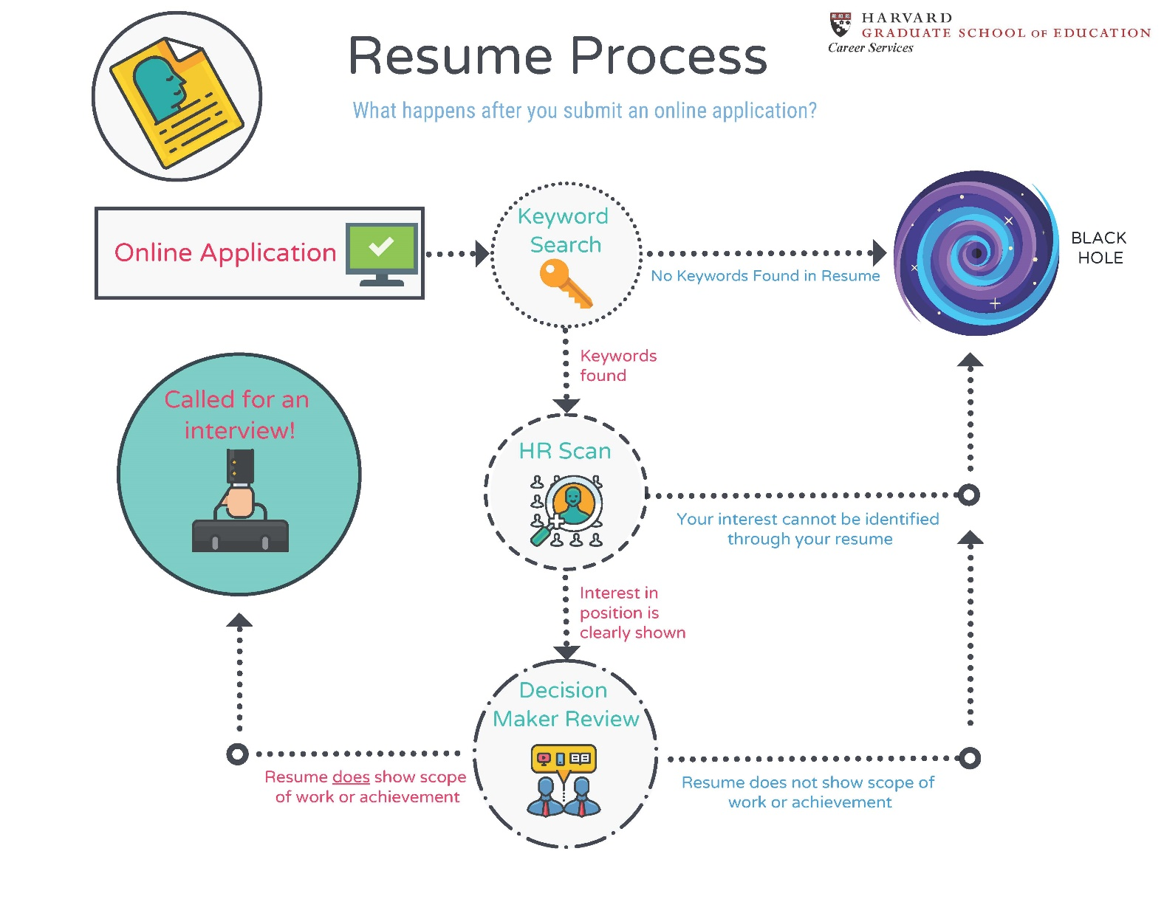
Review of Online Application Process
Notes:
As a reminder of the online application process: , it’s important to understand how online application process works
ATSs review for keywords
HR reviews for organization and clear indication of why applying
Hiring director reviews for breadth, depth and scope of experience

Slide 9
Customize, Apply, and Follow-up
Customize each resume
Submit 2-3 applications/week
Follow up!
Notes:
Hopefully you now have a basic resume that you can customize for each position relatively quickly. As we discussed in the fall, resumes, cover letters and profiles are all strategic documents and tailoring them to match your audience is key to a successful job search. Now it’s time to start tweaking the resume to fit the particular job description.
A few reminders:
Ideally, you will want to submit maybe 2-3 applications per week as a starting point, starting in February to give you a June / July start-date.
You must meet all the basic skills and requirements in the job description. Even if that means finding a way to leverage previous experience in a new way, you still need to address it.
Important to schedule follow-ups on your tracking sheets – interviewers, contacts at the org, hiring directors – even if it says “do not contact”, that generally means do not contact HR; it’s still valuable to follow up.
Interviewers—people you have done informational interviews with can be useful in forwarding resumes to decision-makers, so good idea to keep them posted on your progress—especially if you had a good connection and you apply to the organization they work for
Direct Supervisor – follow up with the Direct Supervisor if possible to underscore your interest in the position, see if there are any questions, and ask about their timeline.
Additional tips for following up:
If open application timeline and within 2 weeks of opening, follow up after 2 weeks.
If there is a designated deadline, follow up 2 weeks after that.
If the posting has been up for more than 2 weeks, follow up immediately with interest.
If you get stuck on a resume, a good idea to help align your experience with a prospective job or type of job, it’s a good idea to do or redo a gap analysis based on the job description – and come in for coaching.

Slide 10
Next Up
Interview prep
Salary negotiation
Step-ahead Resources:
https://cso.gse.harvard.edu/interview
https://cso.gse.harvard.edu/negotiations
Notes:
In the next few months, we will have sessions on interview prep and salary negotiation.
If you want to get a head start, you will find information on both these topics on the CSO websites.

Slide 11
Resource Links
Guidestar (now merged with Foundation Center to form Candid.org): Hollis → Guidestar → View online
LinkedIn HGSE Alumni page: www.linkedIn.com → Search for: Harvard University Graduate School of Education → Click on Alumni button
Application Trackers: cso.gse.harvard.edu → Engage with Employers → Select nonprofit pathway → Resources
Resumes and profiles: https://cso.gse.harvard.edu/resumes-profiles
Cover Letters: https://cso.gse.harvard.edu/cover-letters-portfolios
Events on Hub: https://communities.gse.harvard.edu/hgsehub/s/
Tips on using Guidestar and LinkedIn

Slide 12
Any questions?
Feel free to email me on Hub anytime!

