Slide 1



Slide 2

Cover Letter Working Session
with Rachel Gakenheimer, Internships Manager
And Roger Dempsey, Licensure Specialist
Thursday, November 3, 4-5pm
Larsen G01

Slide 3
Cover Letters:
Purpose
Opportunity to introduce yourself:
Tell them why you are interested and how your experience meets their needs
Elaborate on any special qualifications
Highlight your successes
Guide the reader (what to focus on & what to consider)
It’s also a screen:
Do you seem to understand the mission and values of the employer?
Did you tailor the cover letter to the needs of the specific job?
Can you articulate yourself well?

Slide 4
Cover Letter Format:
Content
1st paragraph: Orient the reader
Indicate position you’re applying for & how you heard about it
Tell why you are interested
Introduce any key contacts
Summarize in one sentence your qualifications
2nd - 4th paragraph: Show how your experience relates to what they need
Use examples to show fit between skills, knowledge, and qualifications and position offered
Focus on what you can do for them (instead of why you want the position)
Expand on bullets from resume (focus on success and scope of work)
Highlight important experiences, key assets that will enhance your contribution
Last paragraph: Clarify what happens next
Tell them when you will contact them
Thank them!

Slide 5
Cover Letter Format:
Review
Dear Mr./ Ms. xx,
INTRO:
I’m excited to apply for the Boston Program Coordinator position. I found the position on HGSE’s HIRED database and have since spoken with [your colleague] who further inspired me to apply. My skills empowering and engaging citizens through local action as well as my teaching and leadership experience are well aligned to the requirements for this position.
HOW ALIGNED: experience with urban youth; leadership, teaching, advocacy skills;
As a native of [an urban community], I am well aware of the many challenges that face urban communities. I was fortunate [to work with a club that] led me to register many people to vote, educate citizens on bond referendum that provided my school district with $150 million dollars, and advocate to stop the reintroduction of corporal punishment into my school district, amongst many other successes.
My early experiences heavily influenced my future endeavors and have continued to inspire my passion for youth and community. They drew me to HGSE to study literacy, bilingualism, and how children in stressful situations can better learn and where I built a model curriculum that has been adopted by the local school district. I look forward to using these skills to further your projects [x, y, and z] I believe that my unique experiences … all make me an excellent candidate for the position.
NEXT STEPS:
Thank you so much for your time, and please feel free to contact me with any questions by phone at (617) 555-1212 or email at email@email.com. I will also follow up on [this date] to see if you have any questions.

Slide 6
Tips Review Checklist
Deconstruct and analyze the job description
Understand the mission of the organization and how it contributes to the industry
Clearly state the position you are applying for
Articulate how you can help the organization achieve its goals
Use examples to show fit between your education, experience, and skills and the position offered
Give examples of qualities required for the job
Proof-read your letter for typos and misspellings
Also check:
Do you feel good about your letter? Do you feel that it represents you well?

Slide 7
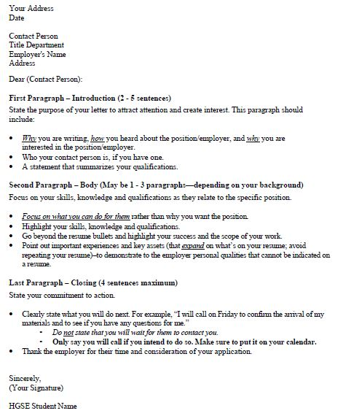
Cover Letter Handouts:
Structure

Slide 8
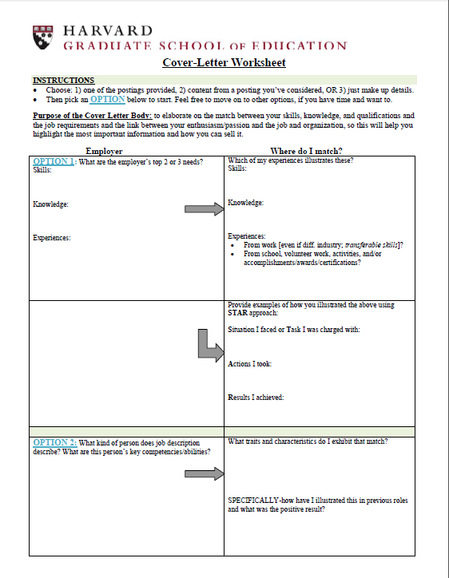
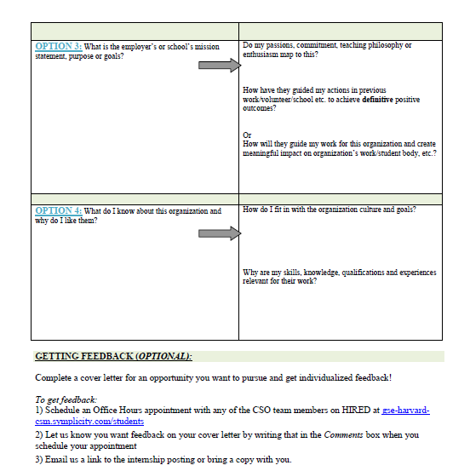
Cover Letter Handouts:
Critique

Slide 9

Any questions?
Visit HIRED to set up an Office Hours appt
or
For quick questions, email rachel_gakenheimer@gse.harvard.edu

