Slide 1

EdConnect
Success Strategies

Slide 2
Decide on Event Goals
Career Exploration
Job Search
Working Smarter

Slide 3
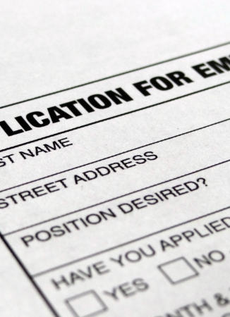

Job Search Success
Search jobs
Apply prior to event
Note when you will be in town on your cover letter and the date of your visit
This Photo by Unknown Author is licensed under CC BY-SA
This Photo by Unknown Author is licensed under CC BY-SA

Slide 4

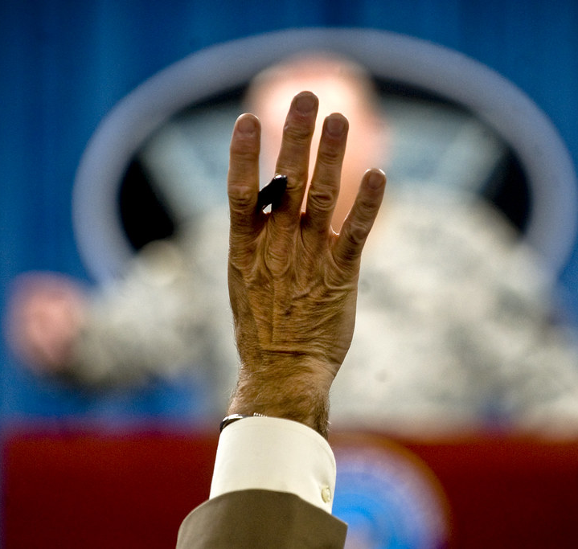
Develop Questions
Early Arrival
Be Proactive
Follow-up
This Photo by Unknown Author is licensed under CC BY-SA-NC
This Photo by Unknown Author is licensed under CC BY

Slide 5

Stay Connected
This Photo by Unknown Author is licensed under CC BY-SA-NC
Follow or connect
Send updates
Let them know when you have applied to a position.

Slide 6
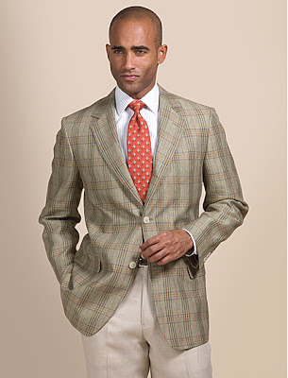

Dress
For the work environment
This Photo by Unknown Author is licensed under CC BY-NC-ND
This Photo by Unknown Author is licensed under CC BY-NC-ND

Slide 7
Cancellation Policy
If you are unable to attend a session, you will need to cancel with the organization prior to the session. If you miss the session due to an emergency, you are expected to send an apology to the organizations contact with a copy to Valerie_Sutton@gse.Harvard.edu.
If the above procedure is not followed, you will be required to meet with the Career Services Director to be able to access future events.

