Slide 1



Slide 2
Agenda
Document Details - complete and put large envelope
Licensure Services
Timelines
Common Questions
Action Items
Notes:
Licensure Services (mention job letters)

Slide 3
What about principal license grade levels?
Does it impact my ability to get a license outside of Massachusetts?
Notes:
Tied to grade range of practicum site and T331/332 section A, B, or C
In K-8 settings, you choose the focus-elementary or middle school.

Slide 4
Endorsement statement on your transcript
You will have ONE of the following:
This student has completed a Massachusetts State approved program for licensure in Principal/Assistant Principal, PreK-6, Initial and is endorsed for licensure in this field under terms pursuant to the NASDTEC Interstate Agreement.
This student has completed a Massachusetts State approved program for licensure in Principal/Assistant Principal, 5-8, Initial and is endorsed for licensure in this field under terms pursuant to the NASDTEC Interstate Agreement.
This student has completed a Massachusetts State approved program for licensure in Principal/Assistant Principal, 9-12, Initial and is endorsed for licensure in this field under terms pursuant to the NASDTEC Interstate Agreement.

Slide 5
You work with several systems:
MTEL (communication and literacy test) Complete before end of December
MA DESE ELAR system (License application system-where you get a MA ID called MEPID) Look at slide image to see MEPID number.
PAL (performance assessment for leaders) (Won’t be open until October) Know we’ll reach out to you.
Notes:
You do not have to create ELAR account in advance of the MTEL

Slide 6
Create an account in the DESE ELAR system
Apply for license (s) and SEI ADMINISTRATOR ENDORSEMENT
Pay now for license(s) or pay later-but no payment-no license.
Notes:
You can meet with RD or me. We’ll email you a step by step guide for those who prefer that resource.

Slide 8
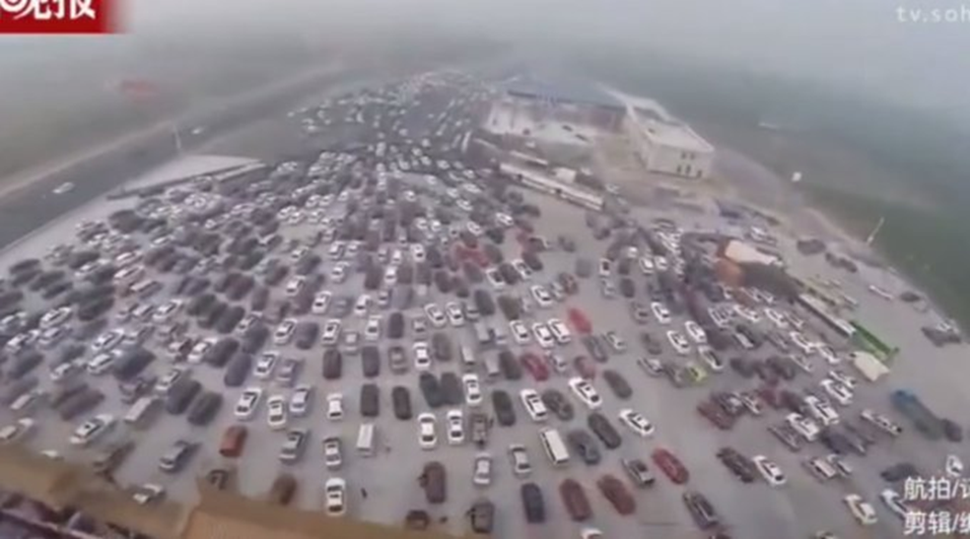
Why is this image important to you?

