Slide 1

Presidential Management Fellows (PMF) Program
The Opportunity for Applicants
With Staci Cummins, HGSE alumna, 2019

Slide 2

Opening Disclaimer
As a PMF Ambassador, I do not speak on behalf of the U.S. Office of Personnel Management, the PMF Program Office, or any other agency, rather, I speak in my own personal capacity as a Presidential Management Fellow (PMF), and I’m here to:
Outline the basics of the program,
Share how it can serve as a catalyst for leadership in the federal government, and
Talk about the overall value of a career in public service
Encourage you to apply!

Slide 3
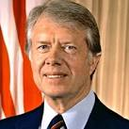
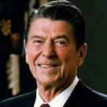
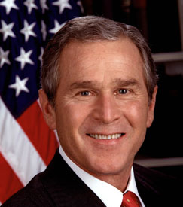
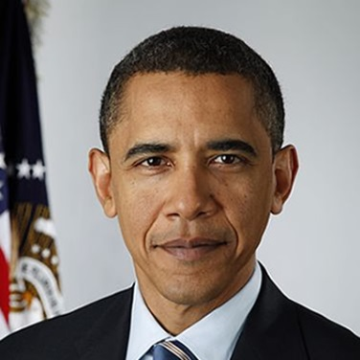
The PMF Program Has a Rich History of Presidential Leadership & Commitment
Celebrating a 40 year legacy of developing high potential graduate degree holders
into visionary leaders who transform government
EO 12008 (1977)
  Presidential Management Intern (PMI) Program
  Attract exceptional management potential with special training in planning/ managing public programs & policies
  Schedule A 2-year appointments
  Public management backgrounds
EO 12364 (1982)
  Candidates with a commitment/interest in analysis and management of public programs
  Maximum of 200 PMIs selected yearly
  Colleges and universities nominate
  EO 12645 (1988)
  Maximum of 400 PMIs selected yearly
EO 13318 (2003)
  Changes name to Presidential Management Fellows (PMF) Program
  Senior PMF for those with degree plus experience
  Schedule A or any organization excepted from competitive service
  Expands training and development requirements
EO 13562 (2010)
  Places PMF within Pathways Programs
  Schedule D Appointing Authority
  Revokes Senior PMF
  Optional for Agencies to convert
  Extends eligibility to include recent graduates
  Eliminates nomination process
3

Slide 4
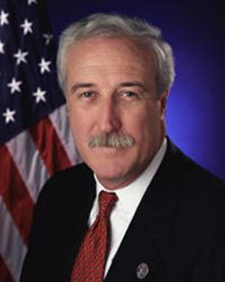
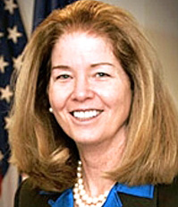
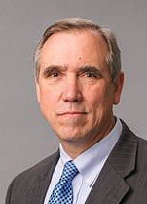
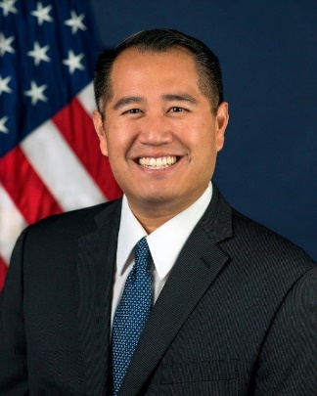
Alumni
The PMF Program recently celebrated its 40th Anniversary, and since its inception, over 10,000 professionals have gone through the program, going on to make significant contributions in the Federal Government.
Here are several examples:
Sean O’Keefe
PMI at OMB
Secretary of the Navy
Administrator of NASA
CEO of Airbus
Current: Professor of Public Administration
Dr. Colleen Hartman
PMI at NASA
Distinguished career at NOAA, the White House and in academia
Current: Board Director at the National Academies of Sciences, Engineering, and Medicine
Sen. Jeff Merkley
PMI at DoD
Oregon House of Representatives
Current: U.S. Senator (OR); Committee on Appropriations; Committee on Foreign Relations
Derek Kan
PMF at Office of Mgmt. and Budget
Board member of Amtrak
General Manager of Lyft
Current: Under Secretary of Transportation for Policy (DOT)

Slide 5
PMF Program Overview
Involves a very competitive and rigorous application and assessment process
Solicits eligible individuals annually
Finalists seek appointments as Fellows
Two-year fellowship of training and development, with potential to be converted to a permanent position
Initial appointment at the GS-9/11/12 (or equivalent)
Promotion potential to the GS-13
Succession Planning for Federal Agencies
Future Leaders for Federal Government

Slide 6
The Fellowship Includes
Onboarding with your fellowship class
Rigorous Leadership Development
160 hours of formal interactive training
At least one 4-6 month Developmental Assignment
Optional Rotational Opportunities
Assignment of senior-level Mentor
Individual Development Plan (IDP)
Opportunity to convert non-competitively to a permanent Federal position upon successful completion of program requirements

Slide 7
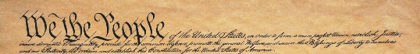
A Call to Serve
Federal Employee Oath of Office
I, [name], do solemnly swear (or affirm) that I will support and defend the Constitution of the United States against all enemies, foreign and domestic; that I will bear true faith and allegiance to the same; that I take this obligation freely, without any mental reservation or purpose of evasion; and that I will well and faithfully discharge the duties of the office on which I am about to enter. So help me God.
5 U.S.C. §3331

Slide 8
The Opportunity and Reward of Civil Service
Make a difference for our nation and the future
A Federal career with full benefits
Award winning leadership development
Challenging work assignments
Exposure to different Federal agency missions
Network with Federal leadership
Apply your skills, education, and talents

Slide 9
Appointment Benefits
Student Loan Repayment Program*
Public Service Loan Forgiveness Program*
Flexible Spending Accounts
Health, Vision, and Dental Insurance
Paid Vacations, Holidays, and Sick Leave
Life Insurance
Long-Term Care Insurance
Retirement Plan and Thrift Savings Plan
Relocation and Recruitment Incentives
*NOTE: Some benefits are at the discretion of each Federal agency.

Slide 10
My Personal Experience with PMF
TFA-SD, 2015
  Worked in a tribally-operated BIE school on the Rosebud Reservation
  District position gave insight into impacts of government policies
EPM, HGSE, 2019
Education Program Specialist for the Rural Education Achievement Program
  RINAP, OESE

Slide 11
Personal Highlights & Takeaways
Currently in search of a rotational appointment
Many PMF alumni at ED (and elsewhere)
  Support systems, professional network, and understanding of other offices/programs
Opportunity for good (or different) work
  BIE MOA
Exercising grad school skills: policy memos, presentations, motivation
DC
  Transient (lots of opportunities)
  A lot to offer

Slide 12
Application Process
Application opens at Noon (EST) on October 3, 2019 and closes at Noon (EST) on October 17, 2019
Announcement is posted on www.USAJobs.gov during the open period
Applicants submit an on-line application to include:
  Resume
  Transcript (and/or alternative)
  Supporting documentation for any claims to Indian preference, veterans’ preference, and/or reasonable accommodations
  Complete an On-Line Assessment
Finalists selected then have 12 months of appointment eligibility
Upon securing position with a participating Federal agency → Fellow
Approximate timelines on PMF website (pmf.gov)

Slide 13
Who Can Apply? How to Apply?
Who Can Apply:
Graduate Students world-wide
Degree from an accredited institution
Must have advanced degree requirements completed by Aug 31st following the application year
May apply within the last year of study OR up to 2 years after completing advanced degree
How to Apply:
Review the “Become a PMF” section on the PMF website (www.pmf.gov) for the next annual application
Follow instructions and link found in announcement posted at www.USAJobs.gov when the application opens
11

Slide 14
Application: Top 3 Common Mistakes
1) Transcript issues
2) Insufficient documentation
3) Waiting until the last minute
11

Slide 15
What to Expect
    Notified within 1 month following application if selected as a Finalist
    Finalists then attend a virtual or in-person hiring fair to interview for open PMF appointment opportunities at a Federal agency
    Finalists have 12 months from date selected to secure a position with an agency as a PMF
    2 year fellowship followed by prospective Federal career
12

Slide 16
Class of 2019 Stats
Total # of Applicants: 4,045
Total # of Finalists: 351 (8.7% acceptance rate)
Academic institutions represented: 113
Total number of unique academic disciplines: 56
Veterans: 12%

Slide 17

Class of 2019
Sample of Degree Programs Represented
Accounting/Finance/Budget | Climate and Society | Ecology | Health Administration | Political Science
Administration/Management Process | Communications | Economics | History | Psychology
Aerospace Engineering | Community/Regional Planning/Development | Education | Hydrology | Public Administration
Anthropology | Comparative Politics | Emergency Management | Industrial Engineering | Public Affairs
Area Studies -- ex. Strategic, Judicial | Computer Science | Environmental Policy/Studies | International Disciplines | Public Health
Biology/Biological Sciences | Conflict Analysis/Resolution | Environmental Sciences/Natural Resources | Law (JD or other law degree) | Religion
Biostatistics | Criminal Justice | Epidemiology | Neurosciences | Social Work
Business Management/Administration | Cyber Security/Information Security | Forestry | Non-profit Management | Sociology
Chemistry | Defense/Terrorism | Geospatial Analysis | Physics | Toxicology
Civil Engineering | Diplomacy | Government | Policy Analysis | Other Subject Areas (as specified in resume)

Slide 18
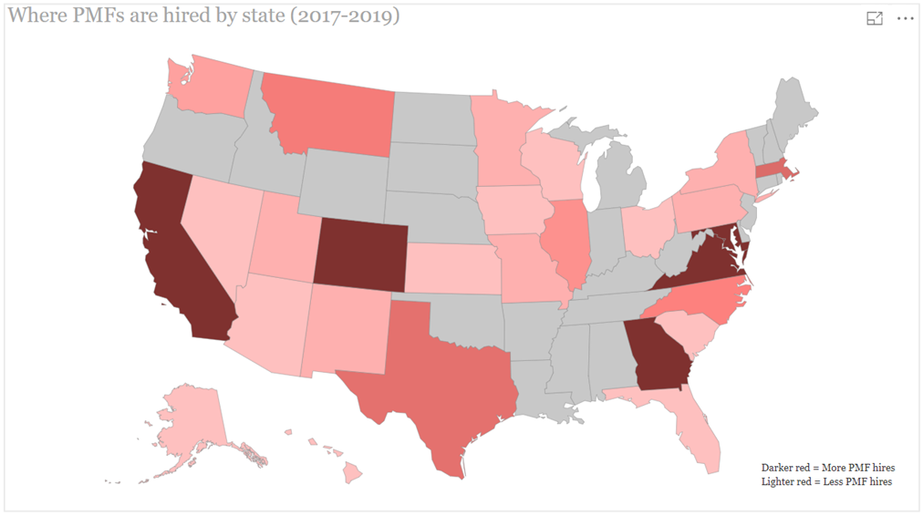
Where PMFs are hired
(All over the country!)
12

Slide 19
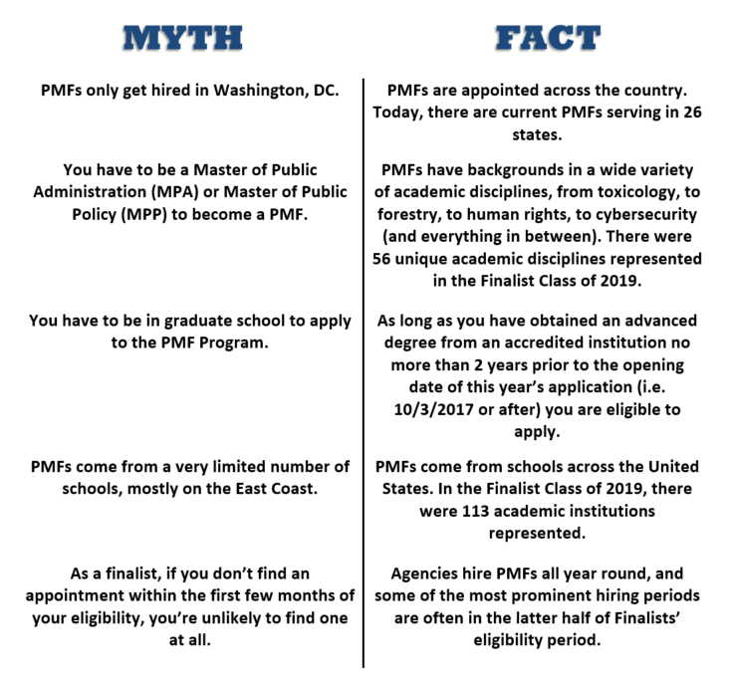
PMF Program
Myths vs Facts
12

Slide 20

Learn More
Presidential Management Fellows Program
U.S. Office of Personnel Management
1900 E Street NW, Room 2469
Washington, DC 20415
Website: https://www.pmf.gov
Subscribe to PMF listserv from homepage
Review “Become a PMF” section on PMF website
Application and Assessment Inquiries: pmfapplication@opm.gov
My personal email: anastasia.cummins@ed.gov

Slide 21
Learn More
Presidential Management Fellows Program
U.S. Office of Personnel Management
1900 E Street NW, Room 2469
Washington, DC 20415
Website: https://www.pmf.gov
Subscribe to PMF listserv from homepage
Review “Become a PMF” section on PMF website
Application and Assessment Inquiries: pmfapplication@opm.gov
My personal email: anastasia.cummins@ed.gov

