Slide 1



Slide 2
Resume Workshop
with Rachel Gakenheimer, Internships Manager,
and
Roger Dempsey, Licensure Specialist, HGSE Career Services Office
Thursdays, April 13 and 27, 4-5pm
Larsen G01

Slide 3
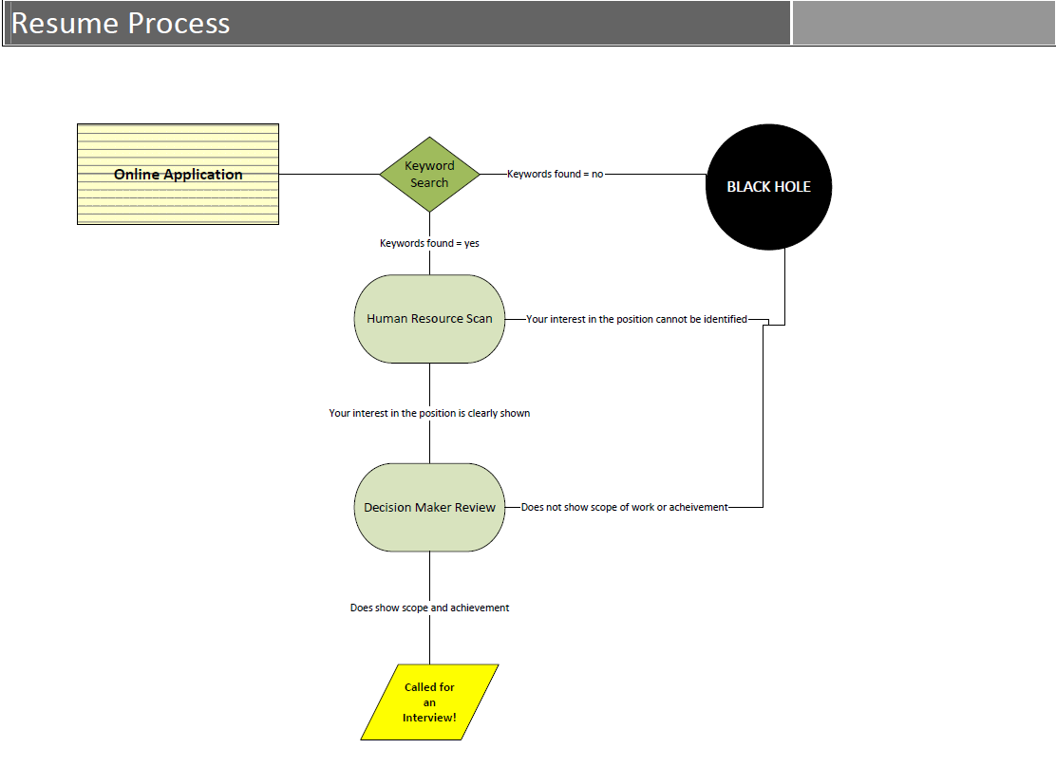

Slide 4


Slide 5
Organizing Your Story:
Focus Areas
Sample JOB DESCRIPTION RESPONSIBILITIES
The Program Director will have responsibilities in the following areas:
Program Development
Define the program’s policy goals, intermediate objectives, priority activities, and benchmarks for measuring progress and relate those goals to the Foundation’s overall mission;
Monitor the field: reading, attending meetings, developing relationships so as to understand emerging issues, research, political, and technological developments that affect the program;
Proposal Evaluation and Project Oversight
Evaluate proposals to determine if: the proposed project is consistent with and could further the policy goals of the program; the applicant has the staff, resources, policy opportunities, and strategy to carry out the proposed project successfully
Present at proposal review meetings recommendations for action on funding requests and the reasons for the recommendations;
Management of Program Team
Meet with program team members – an Education Program Officer and an Education Program Assistant – to develop performance plans and their implementation; provide appropriate feedback on performance in annual review; provide training, mentoring, and oversight for program team;
Provide leadership in and coordinate planning and implementation of strategic directions; track program budget and ensure that program team is on track with goals and benchmarks set in planning process; ensure that schedules for program development and proposal review are adhered to and that deadlines for board book preparation, providing materials for other foundation functions such as communications, and other tasks are met.
External Relations
Responsible for developing and maintaining relationships with x, y, z

Slide 6
Organizing Your Story:
Format
Sample Resume: Hybrid
Your Name
Email Address * Phone Number
_______________________________________________________________________________________________
Program Development Experience
ORGANIZATION NAME 2016-present
Your role
• Defined the program’s benchmarks for measuring progress and ensured those goals to the ;
• Developed relationships to understand (xxx) issues, research, political, and technological developments that affect the program
ORGANIZATION NAME 2014-2015
Your role
• Examined and refined a grant budget that (shows how prudently maximized goals);
• Solicited proposals consistent with the program’s strategy and goals through a process of reviewing letters of inquiry, site visits, and other meetings;
Proposal Evaluation Experience
ORGANIZATION NAME 2015-2016
Your role
• Evaluated proposals to (and how you used your skills to evaluate said proposal);
• Presented …
• Worked closely with
• Monitored projects and grant reports …
Program Management Experience
ORGANIZATION NAME 2012-2014
Your role
• Facilitated the development of performance plans and their implementation; provide appropriate feedback on performance in annual review; provide training, mentoring, and oversight for program team;
• Managed x program…

Slide 7
Organizing Your Story:
Format
Sample Resume: Reverse chronological
Your Name
Email Address * Phone Number
_______________________________________________________________________________________________
ORGANIZATION NAME 2016-present
Your role
• Defined the program’s benchmarks for measuring progress and ensured those goals to the ;
• Developed relationships to understand (xxx) issues, research, political, and technological developments that affect the program
ORGANIZATION NAME 2015-2016
Your role
• Evaluated proposals to (and how you used your skills to evaluate said proposal);
• Presented …
• Worked closely with
• Monitored projects and grant reports …
ORGANIZATION NAME 2014-2015
Your role
• Examined and refined a grant budget that (shows how prudently maximized goals);
• Solicited proposals consistent with the program’s strategy and goals through a process of reviewing letters of inquiry, site visits, and other meetings;
ORGANIZATION NAME 2012-2014
Your role
• Facilitated the development of performance plans and their implementation; provide appropriate feedback on performance in annual review; provide training, mentoring, and oversight for program team;
• Managed x program…

Slide 8
Organizing Your Story:
Narrative
Places and ways to narrate your experience
Summary of Qualifications
  Commitment to lower-income educational issues as evidenced by 15 years of progressively responsible non-profit leadership roles and public service.
Way you describe your experience
  Ensure you’re relating your experience to the position you’re applying for:
    Teaching experience: Taught new science area to 50 6th graders
    Research position relevance: Researched and developed new curriculum for new science area for 6th grade level; evaluated student progress using xxx.
Education
  1-5 yrs exp: first; mid-senior level: first or last (strategic)
Course work
  Within existing categories or under Project Experience:
    Name of Project, Name of Course, HGSE, & What you did (in bullets)

Slide 9
Success and Scope of Work:
Make Your Resume Stand Out
Summary of Qualifications: Commitment to lower-income educational issues as evidenced by 15 years of progressively responsible non-profit leadership roles and public service. Initiated efforts to address these issues by running for public office, fundraising and providing leadership development and academic counseling to nearly 2000 underserved students. Managed alumni fundraising campaigns and events with 53-70% participation rates. Experienced supervisor, managing budgets of over $3 million and 28 staff.
Deputy Executive Director for Leadership Development
Supervised 14 full-time staff members in delivering academic counseling, college guidance, public policy internship and employment to over 450 high school students
Managed budget of over $1.7 million
Built relationships with NYC independent school administrators to manage xxx
Managed staff and teachers during 16 separate three-night / four-day leadership development retreats
Developed and supervised planning of 11 week-long overnight college trips for 150 high school students
Managed relationships with other nonprofit organizations to ensure that xxx
Director of Leadership Development and College Guidance
Managed staff of 8 full-time staff members
Served as head guidance counselor for 140 high school seniors on college application process.

Slide 10
General Tips
Margins can be as small as .5”
Smallest font size should be 10 (use best judgment)
White space can increase legibility
Avoid curlicue fonts, text boxes, or other images
Review, review, review for spelling and grammar
Always follow sector standards & think from the reader’s perspective
Resumes are subjective—have it reviewed from multiple perspectives
Education resumes generally 2 pages (other sectors may differ)
If printing, print one-sided pages and use paper clip (not staples)
Send in format requested (usually Word doc)
Send copies to employees you did informational interviews with

Slide 11
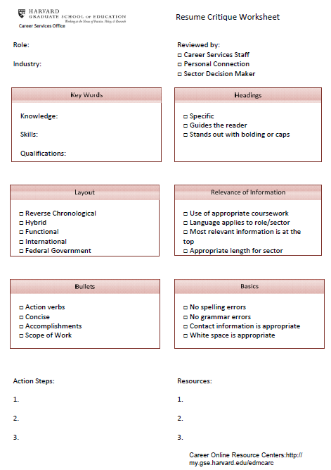

Slide 12

Any questions?
Come in for an Office Hours appt by scheduling one on HIRED or contacting our front desk at 617 495 3427 or emailing cso@gse.Harvard.edu.

