Slide 1



Slide 2
Resume Workshop
with Rachel Gakenheimer, Internships Manager,
and
Roger Dempsey, Licensure Specialist, HGSE Career Services Office
Thursdays, April 13 and 27, 4-5pm
Larsen G01
Notes:
Welcome to this Resume Workshop.
This will be a working session. We’ll start with a quick overview of the structure of a resume, I’ll take questions, and then we’ll get to work on individual resumes and Roger Dempsey and I will come around and answer any questions.

Slide 3
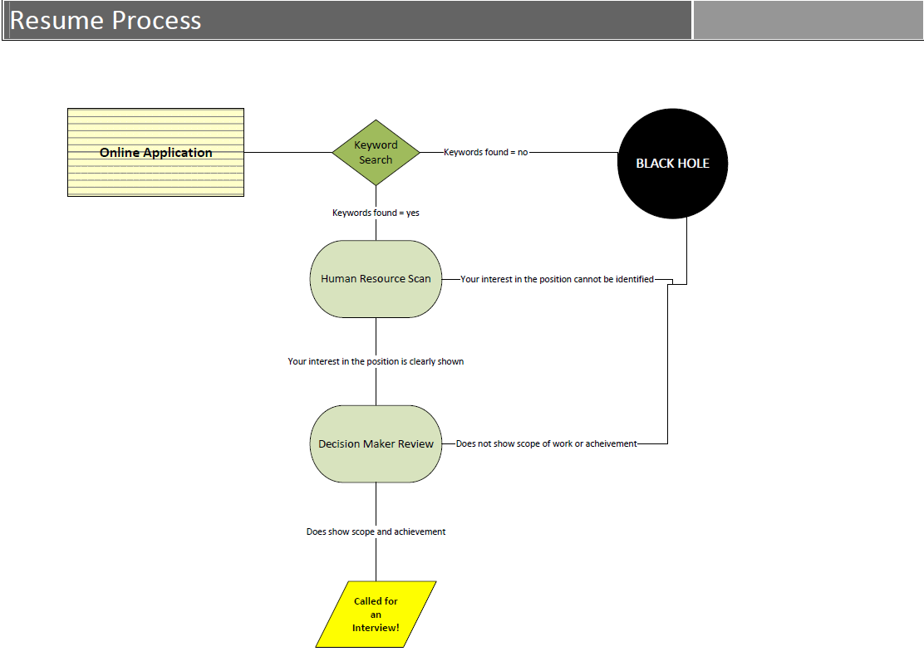
Notes:
First thing I want to do is focus our attention on the purpose of a resume. What is the purpose of a resume? Hint: it’s not to get you a job.
A: It’s to get you an interview.
Each position is likely to receive tens if not hundreds of applicants, so this process is designed to cull that list quickly. So, in addition to thinking about making an impact with your resume, you will want to keep the following process in mind.
A computer reads for keywords. Make sure they’re there! (Note: depending on how the organization has set up their system, the computer may or may not recognize words in lists, so make sure they are embedded in your bullets whenever possible. In addition, curlicue fonts, text boxes, and images can confuse the computer, so leave them out.
If the computer does not find the keywords it’s looking for, your resume will end up in the black hole—no matter how compelling. If the computer does find the keywords, your resume will be forwarded to HR.
HR reviews for your interest in the position—for about 20 seconds. They will check for bolding, grouping (i.e., headings), organization (is your interest / narrative easily intelligible?) Keep in mind: He or she is likely to send about 10 resumes to the decision-maker, so they’re looking for ways to cull the list. Don’t give them any reason to toss your resume aside by overlooking typos, for example.
If HR does not find your interest clearly articulated, your resume will end up in the black hole. If HR does find your interest clearly defined, you are likely to move on to the decision-maker.
The decision-maker looks for your depth and scope of experience (does it look like you can take on the position and succeed and benefit the organization and the team?). The decision-maker is likely to want to interview maybe 3 or 4 candidates, so, again, he or she is looking for ways to cut people out.
If the DM is not able to ID relevant depth and scope of work and experience, your resume will end up in the black hole. If the DM is able to identify such experience, you may get an interview!
I say “may” because there are, of course, things that factor into the decision that we may not know about. So, we’re going to focus today on what we do know about. How can you find out about those nuanced factors that feed into decision-making? This is where your own research and informational interviews can be very helpful. But that’s a workshop for another day. In the meantime, feel free to come in for office hours to ask questions about those topics.

Slide 4

Notes:
There are various ways to approach the resume-building process.
One thing to remember is that resumes are best when targeted to a particular job posting. So it can be useful to view the job description from different perspectives to see what angles you might take advantage of to position yourself.
One way to do this is by using a Wordle (wordle.com)—Has anyone used this?
Get a sense of your resumes relevance to a job description, by putting the text into a Wordle : http://ww12.wordle.com/
The more the word features in the description, the larger the font.
Use to inform your use of words in your resume—especially verbs and keywords.

Slide 5
Organizing Your Story:
Focus Areas
Sample JOB DESCRIPTION RESPONSIBILITIES
The Program Director will have responsibilities in the following areas:
Program Development
Define the program’s policy goals, intermediate objectives, priority activities, and benchmarks for measuring progress and relate those goals to the Foundation’s overall mission;
Monitor the field: reading, attending meetings, developing relationships so as to understand emerging issues, research, political, and technological developments that affect the program;
Proposal Evaluation and Project Oversight
Evaluate proposals to determine if: the proposed project is consistent with and could further the policy goals of the program; the applicant has the staff, resources, policy opportunities, and strategy to carry out the proposed project successfully
Present at proposal review meetings recommendations for action on funding requests and the reasons for the recommendations;
Management of Program Team
Meet with program team members – an Education Program Officer and an Education Program Assistant – to develop performance plans and their implementation; provide appropriate feedback on performance in annual review; provide training, mentoring, and oversight for program team;
Provide leadership in and coordinate planning and implementation of strategic directions; track program budget and ensure that program team is on track with goals and benchmarks set in planning process; ensure that schedules for program development and proposal review are adhered to and that deadlines for board book preparation, providing materials for other foundation functions such as communications, and other tasks are met.
External Relations
Responsible for developing and maintaining relationships with x, y, z
Notes:
To organize your story, a good place to start is by reviewing the job description.
Identify the key roles, functions and verbs the writer uses to describe the position. Highlight things you have in your experience as well as those that you will need to think more about how to match by leveraging other past experience.
However you do it, pull out themes and verbs to use to organize your resume.

Slide 6
Organizing Your Story:
Format
Sample Resume: Hybrid
Your Name
Email Address * Phone Number
_______________________________________________________________________________________________
Program Development Experience
ORGANIZATION NAME 2016-present
Your role
• Defined the program’s benchmarks for measuring progress and ensured those goals to the ;
• Developed relationships to understand (xxx) issues, research, political, and technological developments that affect the program
ORGANIZATION NAME 2014-2015
Your role
• Examined and refined a grant budget that (shows how prudently maximized goals);
• Solicited proposals consistent with the program’s strategy and goals through a process of reviewing letters of inquiry, site visits, and other meetings;
Proposal Evaluation Experience
ORGANIZATION NAME 2015-2016
Your role
• Evaluated proposals to (and how you used your skills to evaluate said proposal);
• Presented …
• Worked closely with
• Monitored projects and grant reports …
Program Management Experience
ORGANIZATION NAME 2012-2014
Your role
• Facilitated the development of performance plans and their implementation; provide appropriate feedback on performance in annual review; provide training, mentoring, and oversight for program team;
• Managed x program…
Notes:
You are most likely going to use a hybrid or reverse chronological format for your resume.
Hybrid
Break down your history in categories
it’s what you’ve done by skill category
This format is useful if the new job is a blend of previous experience or you are transitioning to a new role/function/field
(go back to previous slide – remember program development, proposal evaluation?—those). If those are categories that work for your work and experience history, you will use them, possibly in the order written or in the order of importance for you or your history.
Tip: even in Hybrid, within categories, you’ll use reverse chronological order too

Slide 7
Organizing Your Story:
Format
Sample Resume: Reverse chronological
Your Name
Email Address * Phone Number
_______________________________________________________________________________________________
ORGANIZATION NAME 2016-present
Your role
• Defined the program’s benchmarks for measuring progress and ensured those goals to the ;
• Developed relationships to understand (xxx) issues, research, political, and technological developments that affect the program
ORGANIZATION NAME 2015-2016
Your role
• Evaluated proposals to (and how you used your skills to evaluate said proposal);
• Presented …
• Worked closely with
• Monitored projects and grant reports …
ORGANIZATION NAME 2014-2015
Your role
• Examined and refined a grant budget that (shows how prudently maximized goals);
• Solicited proposals consistent with the program’s strategy and goals through a process of reviewing letters of inquiry, site visits, and other meetings;
ORGANIZATION NAME 2012-2014
Your role
• Facilitated the development of performance plans and their implementation; provide appropriate feedback on performance in annual review; provide training, mentoring, and oversight for program team;
• Managed x program…
Notes:
You are most likely going to use a hybrid or reverse chronological format for your resume.
Reverse Chronological
What you’ve done by position and date, most recent first
If you’ve been heading towards this role for most if not all of your career and previous roles build towards this one

Slide 8
Organizing Your Story:
Narrative
Places and ways to narrate your experience
Summary of Qualifications
  Commitment to lower-income educational issues as evidenced by 15 years of progressively responsible non-profit leadership roles and public service.
Way you describe your experience
  Ensure you’re relating your experience to the position you’re applying for:
    Teaching experience: Taught new science area to 50 6th graders
    Research position relevance: Researched and developed new curriculum for new science area for 6th grade level; evaluated student progress using xxx.
Education
  1-5 yrs exp: first; mid-senior level: first or last (strategic)
Course work
  Within existing categories or under Project Experience:
    Name of Project, Name of Course, HGSE, & What you did (in bullets)
Notes:
There are a few different places to narrate your story: Qualifications Summary, the way you describe your experience in bullets, and in your cover letter.
Your education can be part of your narrative too. If student with 1-5 years of experience or highlight that as key component in changing your career, you are likely to want to put your education first.
If you are mid-career or senior level, you may decide to put education first or last, depending. Even if you add it last, you might still add HGSE in the last line of your qual summary to address its part in your trajectory.
You can also add coursework:
Under the skill area or under projects in this format:
Name of project
Name of course, HGSE
What you did:
Analyzed
Completed
Presented

Slide 9
Success and Scope of Work:
Make Your Resume Stand Out
Summary of Qualifications: Commitment to lower-income educational issues as evidenced by 15 years of progressively responsible non-profit leadership roles and public service. Initiated efforts to address these issues by running for public office, fundraising and providing leadership development and academic counseling to nearly 2000 underserved students. Managed alumni fundraising campaigns and events with 53-70% participation rates. Experienced supervisor, managing budgets of over $3 million and 28 staff.
Deputy Executive Director for Leadership Development
Supervised 14 full-time staff members in delivering academic counseling, college guidance, public policy internship and employment to over 450 high school students
Managed budget of over $1.7 million
Built relationships with NYC independent school administrators to manage xxx
Managed staff and teachers during 16 separate three-night / four-day leadership development retreats
Developed and supervised planning of 11 week-long overnight college trips for 150 high school students
Managed relationships with other nonprofit organizations to ensure that xxx
Director of Leadership Development and College Guidance
Managed staff of 8 full-time staff members
Served as head guidance counselor for 140 high school seniors on college application process.
Notes:
The decision-maker will use these categories to determine whether you appear to be a good fit for the position.
Quantify your accomplishments and show your achievements:
Use data whenever possible and useful
Start bullets with strong verbs (e.g., good opportunity to use verbs in job description; also replace nonspecific verbs, like “assisted,” with specific verbs about how you assisted)

Slide 10
General Tips
Margins can be as small as .5”
Smallest font size should be 10 (use best judgment)
White space can increase legibility
Avoid curlicue fonts, text boxes, or other images
Review, review, review for spelling and grammar
Always follow sector standards & think from the reader’s perspective
Resumes are subjective—have it reviewed from multiple perspectives
Education resumes generally 2 pages (other sectors may differ)
If printing, print one-sided pages and use paper clip (not staples)
Send in format requested (usually Word doc)
Send copies to employees you did informational interviews with
Notes:
Also, no curlicue fonts, text boxes, or other images as they can confuse the computer
Yes add your contact info. You may choose to leave off your physical address
Resume etiquette:
Print on one side of a page only with your name on each page
Paper clip the pages together—do not staple
Send in whatever format the employer requests, usually a Word doc.

Slide 11
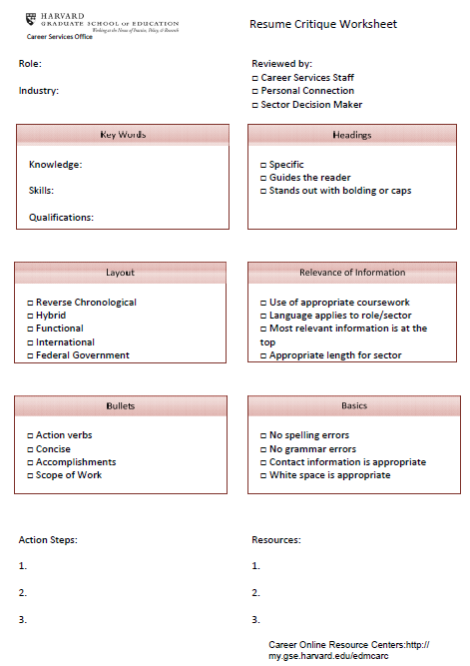
Notes:
Use this as a guideline to work through your resume

Slide 12

Any questions?

